Slide 1
To persons entering or returning to Japan
Persons entering or returning to Japan must submit a questionnaire.
Please enter the necessary information at our Questionnaire Website before you arrive.
As part of the quarantine procedure for the novel coronavirus disease (COVID-19), all persons must submit a questionnaire on which they have filled in information on their travel history and health condition to the quarantine officer upon entering or returning to Japan.
Before you arrive (at home, at the airport, on the airplane, etc.), please enter the required information at our Questionnaire Website, and then present the issued QR code to the quarantine officer when you arrive.
Flow of Questionnaire
Website entry
* An internet connection is necessary for downloading.
Download at your point of departure
On the airplane
When you enter Japan
* To enter the information on the airplane, you must download before boarding.
❶ Enter the information at our Questionnaire Website.
⇒ A QR code is issued.
❷ Present your QR code and passport.
If you enter the information after arriving, entry might take a while, resulting in the quarantine procedure taking time.
* If you do not have a smartphone or tablet and therefore cannot create a QR code at our Questionnaire Website before boarding, you can instead use a computer set up at the airport in Japan after you arrive to enter the information at our Questionnaire Website and create a QR code. However, entry might take a while.
To access our Questionnaire Website, go here:
https://arqs-qa.followup.mhlw.go.jp
* Both smartphones and computers are supported.
Quarantine station, Ministry of Health, Labour and Welfare Japan

Slide 2
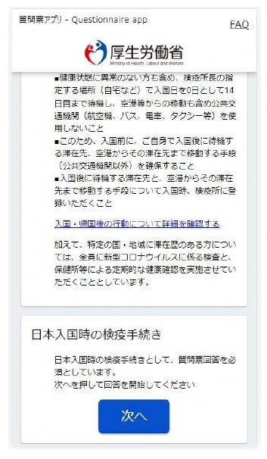
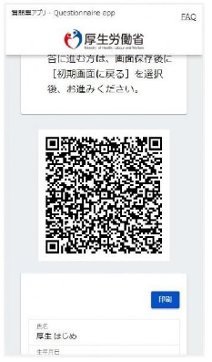
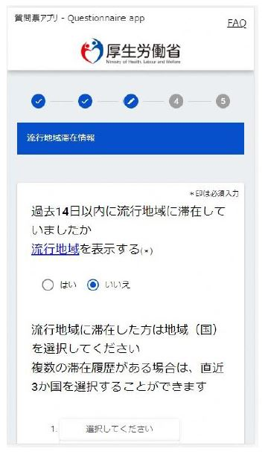
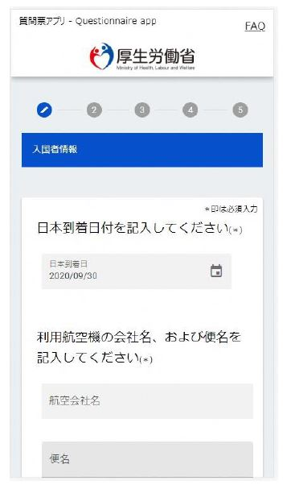
How to use our Questionnaire Website
Access our Questionnaire Website.
Confirm the details on the top page, and then click "Next".
https://arqs-qa.followup.mhlw.go.jp
If using a smartphone (Android or iOS), add the app to the home screen, and then respond from the home screen icon. When using this icon, you can enter your responses while offline.
* There might not be an internet connection at the airport or on the airplane, so please enter the information while offline.
①
②
* A smartphone screen is shown above.
④
③
Save or print the screen showing the issued QR code.
Enter the information on the response form.
* Be sure to keep your QR code safe until the end of the quarantine procedure at the place of arrival.
* If you have any questions, check the FAQ on the website.
Quarantine station, Ministry of Health, Labour and Welfare Japan

